Slide 1



Vehicle Insurance Claim Fraud Detection
View in Power BI
Last data refresh:
25/04/2025 05:00:28 UTC
Downloaded at:
25/04/2025 05:01:21 UTC

Slide 2
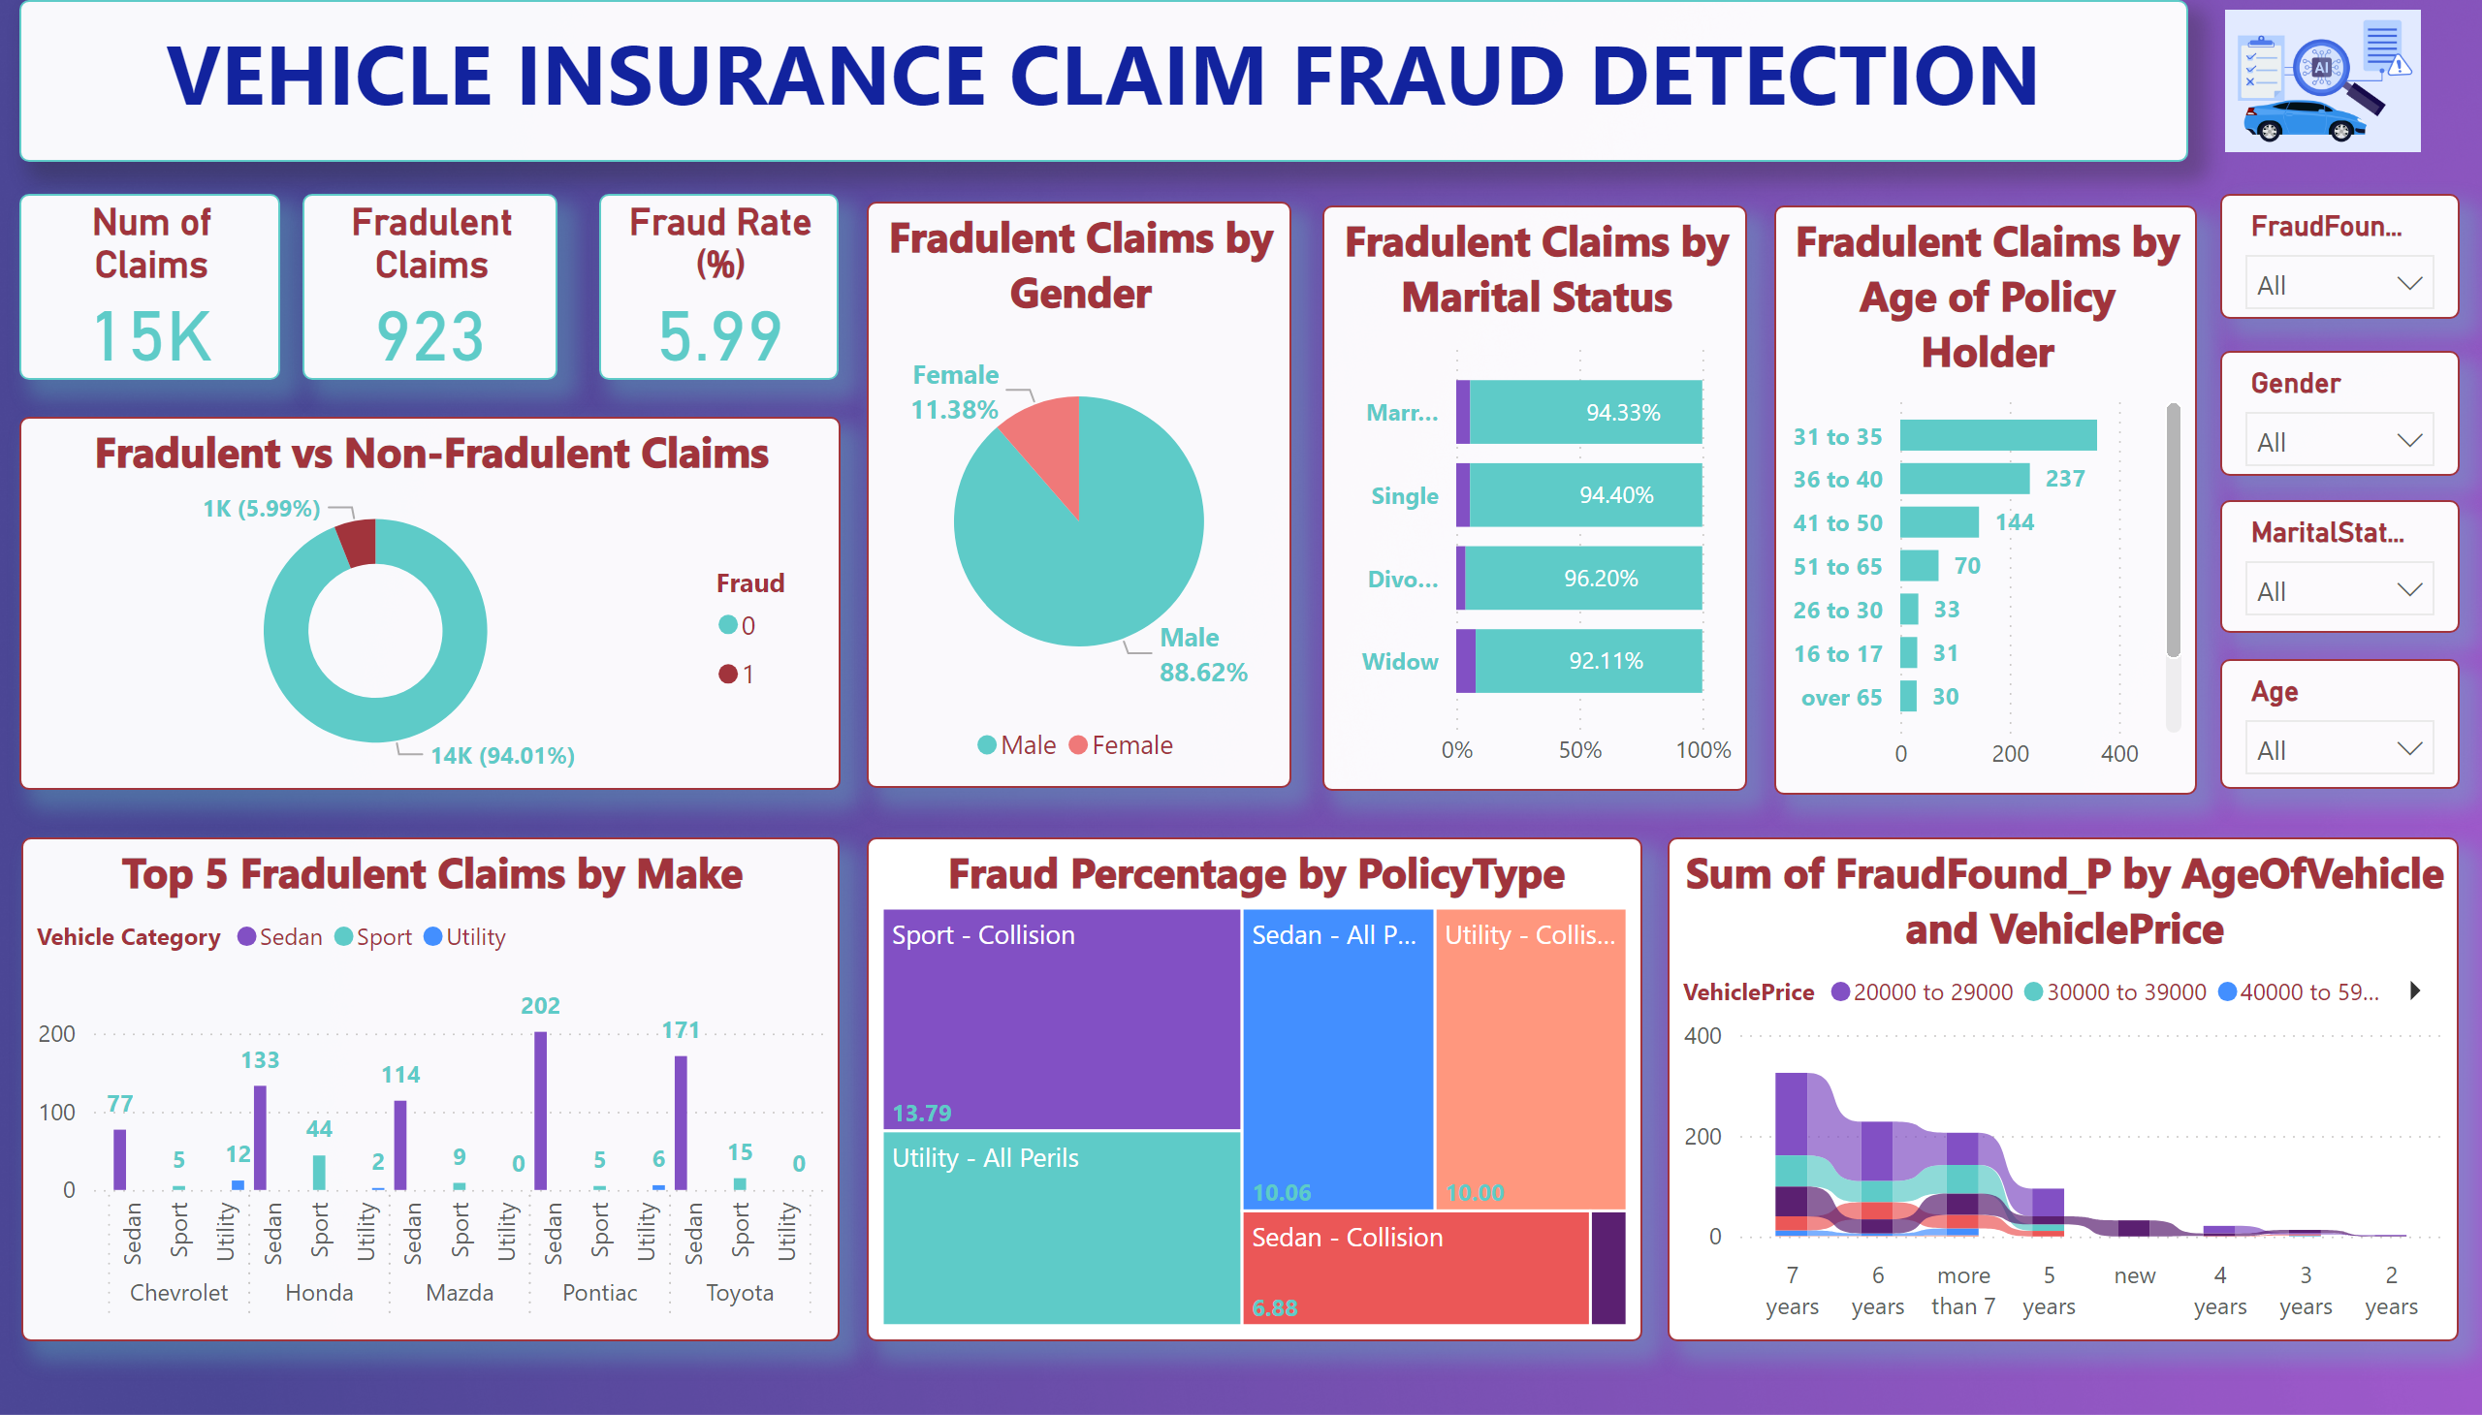
Page 1
Notes:
textbox
No alt text provided
image
No alt text provided
Num of Claims
No alt text provided
Fradulent Claims
No alt text provided
Fraud Rate (%)
No alt text provided
Fradulent vs Non-Fradulent Claims
No alt text provided
Fradulent Claims by Gender
No alt text provided
Fradulent Claims by Marital Status
No alt text provided
Fradulent Claims by Age of Policy Holder
No alt text provided
slicer
No alt text provided
slicer
No alt text provided
slicer
No alt text provided
slicer
No alt text provided
Top 5 Fradulent Claims by Make
No alt text provided
treemap
No alt text provided
ribbonChart
No alt text provided

